Slide 1

Credit Card Fraud Detection
Fraud detection is a set of activities that are taken to prevent money or property from being obtained through false pretenses. Fraud can be committed in different ways and in many industries. Most detection methods combine a variety of fraud detection datasets to form a connected overview of both valid and non-valid payment data to make a decision. The Credit Card Fraud Detection Problem includes modeling past credit card transactions with the knowledge of the ones that turned out to be a fraud. This model is then used to identify whether a new transaction is fraudulent or not. The models to be used will be two unsupervised algorithms such as Local Outlier Factor and Isolation Forest Algorithm. The model will
also include a supervised learning algorithm which will be Random Forest and XGBoost . My aim here is to detect 100% of the fraudulent transactions while minimizing the incorrect fraud predictions.

Slide 2

This project aims to apply different algorithms & techniques on Credit Card Fraud data set and compare the results.
Measures used to compare those are Precision and Recall.
Measure like Accuracy is not good because the data set is highly unbalanced.
MAIN GOAL

Slide 3

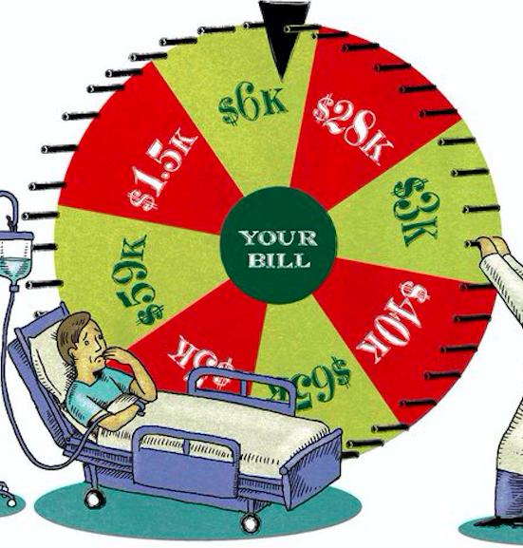
DATASET
The datasets contains transactions made by credit cards. This dataset presents transactions that occurred in two days, where we have 492 frauds out of 284,807 transactions. The dataset is highly unbalanced, the positive class (frauds) account for 0.172% of all transactions.
Due to confidentiality reasons, dataset available is not the original (raw) form but has been reduced using PCA. And the only features which have not been transformed with PCA are 'Time' and 'Amount’.
Weblink:
https://www.kaggle.com/mlgulb/creditcrdfraud/download

Slide 4
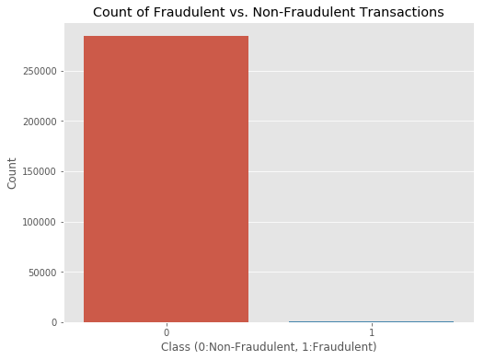
In the class distribution we want to know:
How many transactions are fraudulent and how many are not?
Well, as can be expected, most transactions are non-fraudulent. In fact, 99.83% of the transactions in this data set were not fraudulent while only 0.17% were fraudulent..

Slide 5
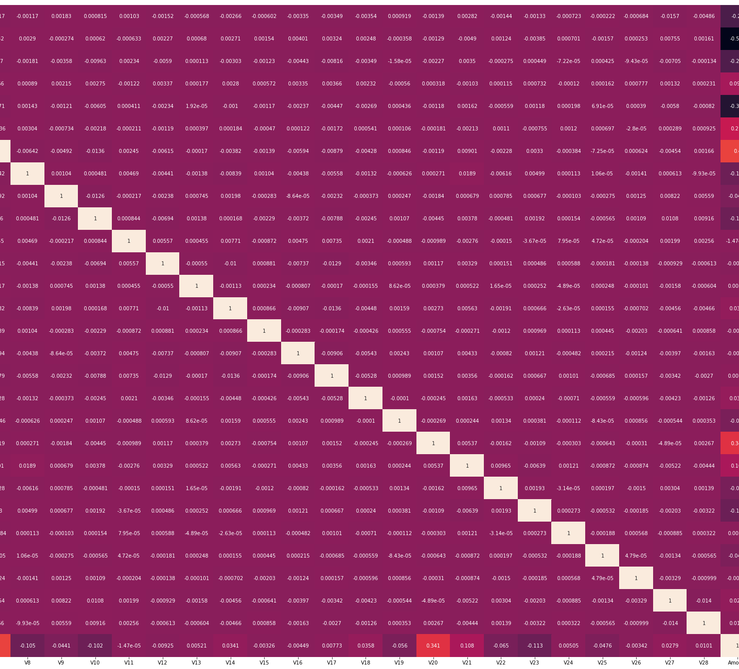
EDA
The purpose of EDA is to enhance our understanding of trends in the dataset without involving complicated machine learning models. Oftentimes, we can see obvious traits using graphs and charts just from plotting columns of the dataset against each other.
A correlation map (or correlation matrix) is a visual tool that illustrates the relationship between different columns of the dataset. The matrix will be lighter when the columns represented move in the same direction together, and it will be darker when one column decreases while the other increases. Strong spots of light and dark spots in our correlation matrix tell us about the future reliability of the model.
From these column values, we can see that there are some very useful correlations present within our new dataset. For example, V2 and V5 are highly negatively correlated with the feature called Amount. We also see some correlation with V20 and Amount. This gives us a deeper understanding of the Data available to us.

Slide 6
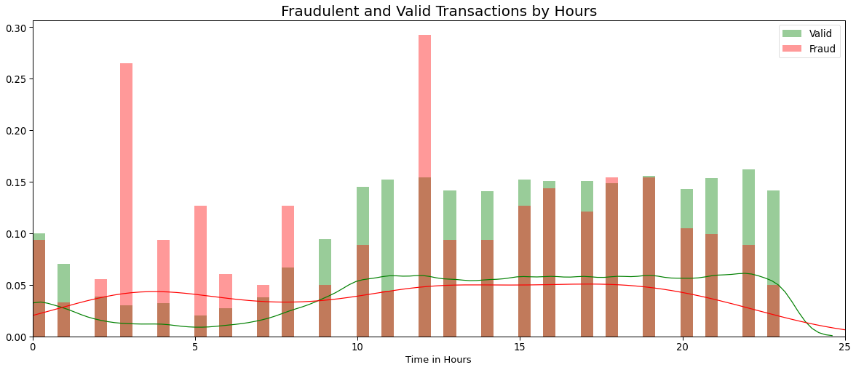
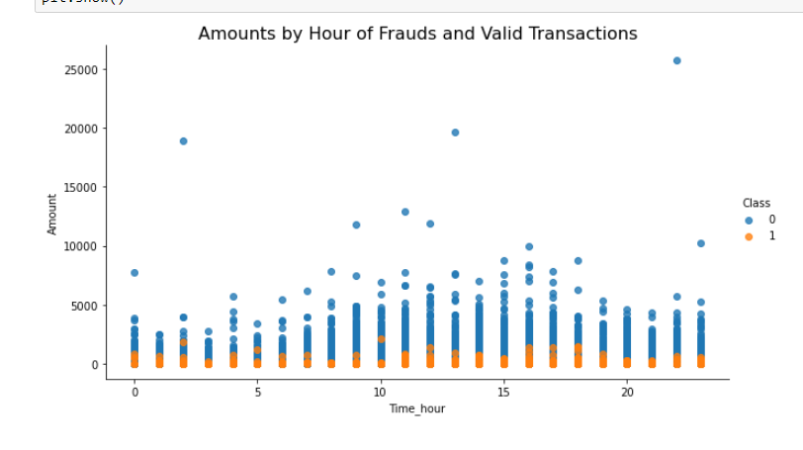
Exploring the distribution by Class types through hours
As we can see ,the most fraudulent transactions happening at 3, 12 o'clock. Fraudulent transactions of the same account didn't happen consecutively.
From the Scatter plots it is clearly visible that there are frauds only on the transactions which have transaction amount approximately less than 2500. Transactions which have transaction amount approximately above 2500 have no fraud.

Slide 7
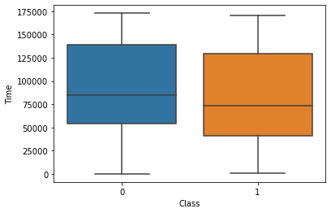
Let’s also plot a pie chart of the distribution between fraud and not-fraud for easier viewing.
By looking at the box plot we can say that both fraud & valid transactions occur throughout time and there is no distinction between them.

Slide 8
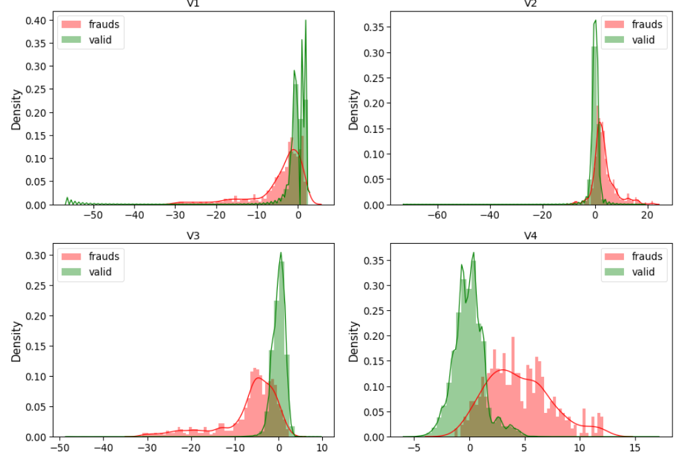
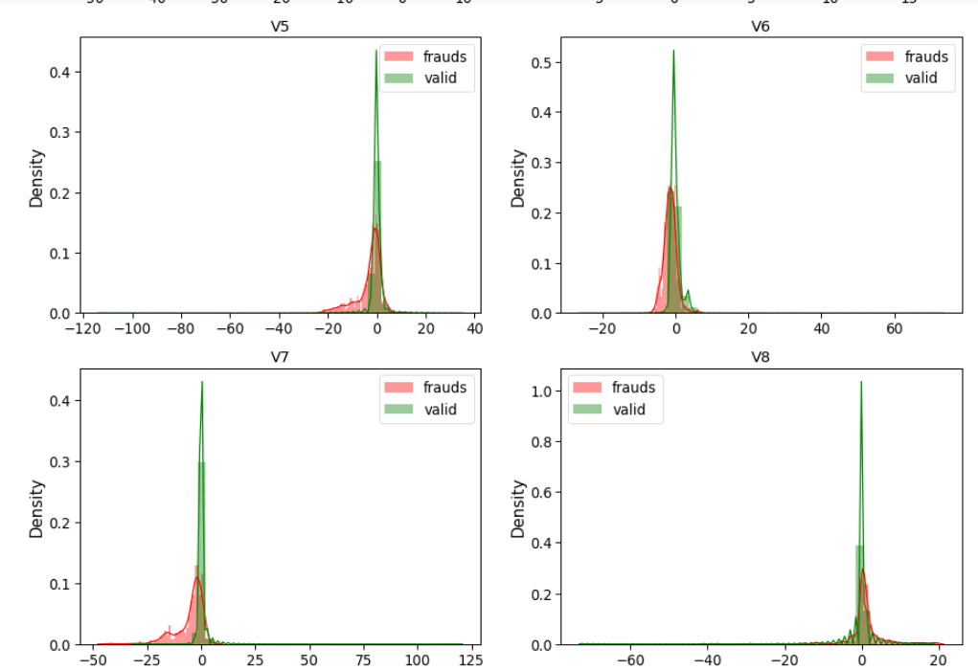
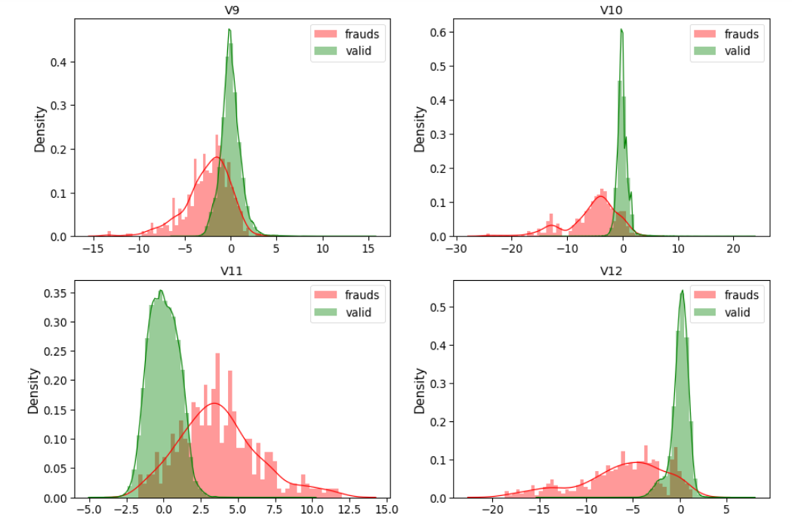
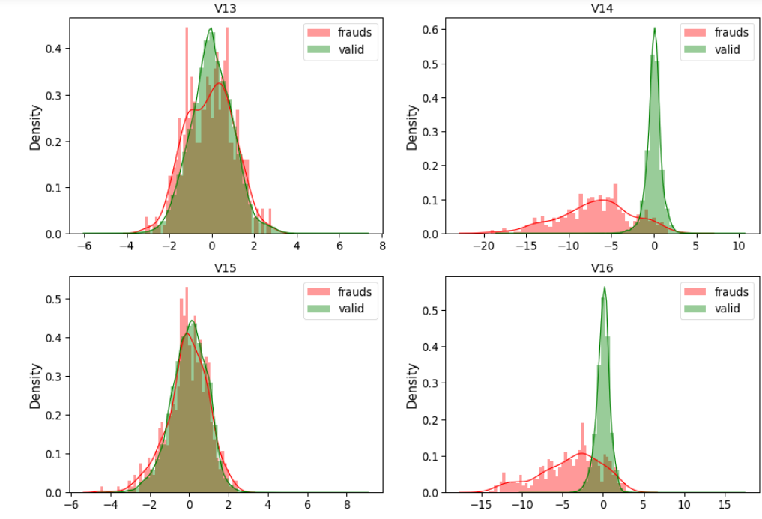
Visualizing all the features from a dataset
On graphs
For some of the features we can observe a good selectivity in terms of distribution for the two values of Class: V4, V11 have clearly separated distributions for Class values 0 and 1(we have portion of data in the right side, skew for fraud in the right and for valid is 0 ). V12, V14, V18 are partially separated, V1, V2, V3, V10 have a quite distinct profile(because the most values cluster on the right and left side). .V15,V22, V25, V26, V28 have similar profiles(they are overlap, impossible to make comparisons for two values of class.)

Slide 9
The purpose of the data preprocessing stage is to minimize potential error in the model as much as possible. Generally, a model is only as good as the data passed into it, and the data preprocessing we do ensure that the model has as accurate a dataset as possible. First check the null values in data set and then I will be dividing the dataset into two main groups. One for training the model and the other for Testing our trained model’s performance. after that we start
To standardize the numeric features and apply scaler to the testing set.
Data preprocessing

Slide 10
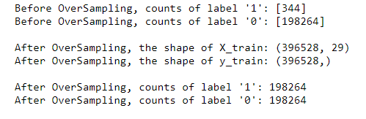
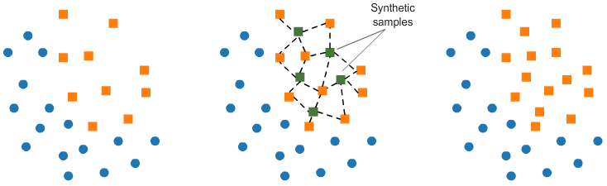
Increase successful detections with data resampling
Oversampling(SMOTE) :
Oversampling the minority class (fraud cases)
Take random draws from the fraud cases and copy those observations to increase the amount of fraud samples
The model will be trained on a lot of duplicates
The goal is to produce a better model by providing balanced data
using SMOTE suddenly gives us more observations of the minority class.
It should be clear that SMOTE has balanced our data completely, and that the minority class is now equal in size to the majority class.

Slide 11
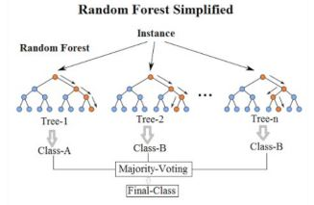
Modeling
I will be creating and training my model for predicting whether a transaction is fraudulent or not. Since there are multiple algorithms, I can use to build my model.
we are using XGBoost, Isolation Forest, RandomForest, Local Outlier Factor to perform my predictions.
In this project I would like to compare 2 machine learning method:
Random Forest
XGBoost
Random Forest
Random Forests are a more robust option than a single decision tree
A random forest consists of a collection of trees on a random subset of features
Final predictions are the combined results of those trees
Very popular for fraud detection
Random Forest prevents overfitting most of the time

Slide 12
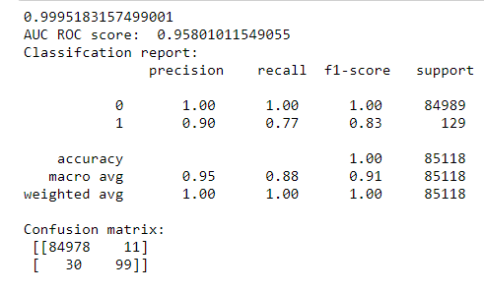
The Random Forest classification report is :
With the Random Forest Classifier with SMOTE Model, we have:
- The model is able to predict only 92% of fraudulent transactions .(precision score)
- 84978 transactions classified as valid and were actually valid(True Positive)(here 84980 are the number of CORRECTLY PREDICTED safe cases).
- 11 transactions classified as fraud but that were really valid(type 1 error)( here 9 are the number of MISCLASSIFIED safe cases. Hence 9 safe cases were misclassified as a fraud. This is potentially less dangerous as it’s better to stop some safe transactions with the slightest chance of fraud.;
- 30 transactions classified as valid, but which were fraud (type 2 error)(here 30 are the number of MISCLASSIFIED fraud cases. hence 30 fraud cases were misclassified as safe. This is very dangerous because we are letting the fraud cases pass through. This can cause a huge loss to the organization.;
- 99 transactions classified as fraud and were actually fraud.
- we have 129 transactions as fraud.
- Look at the precision, recall, f1_score .The accuracy looks good.
The machine learning algorithms for detecting credit card fraud are highly efficient, but there are still gaps to close. One of the biggest problems is the occurrence of False Positives, that is when the algorithm incorrectly detects a fraud. Thus, we are always searching for ways to shrink even more that 3% mark of False Positives.

Slide 13
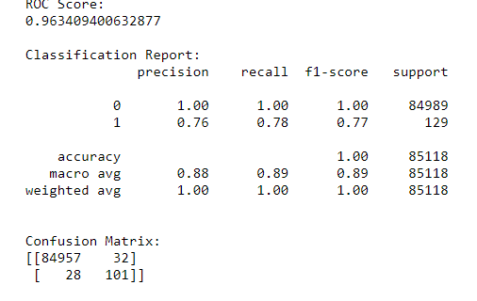
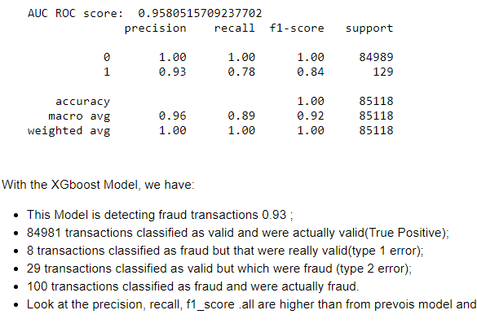
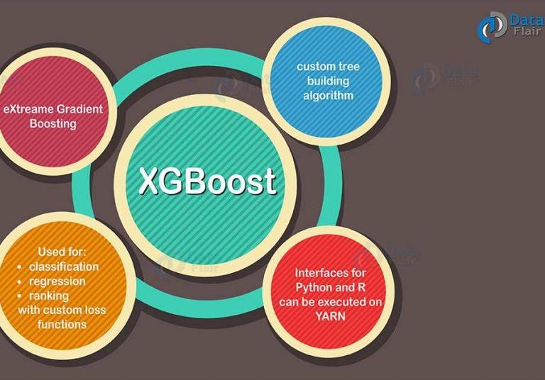
XGBOOST
XGBoost has an inherent ability to handle missing values. When XGBoost encounters node at lost value, it tries to split left & right hands & learn all ways to the highest loss. This is when the test runs on the data.
Let’s see if we can improve their performance through hyperparameter optimization:
I want to use GridSearchCV for hyperparameter tuning.In this approach machine learning is an evaluated for a range of hyperparameter values. but my result didn’t improve.

Slide 14
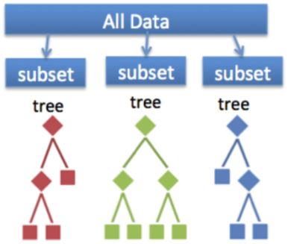
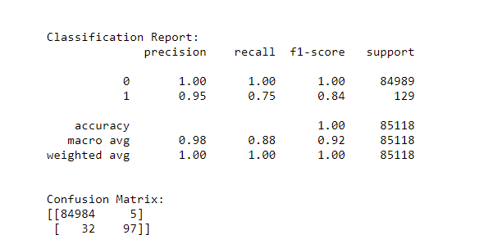
Ensemble methods
To improve my prediction performance, I’ve decided to
use ensemble method like Voting classifier.
Ensemble methods are techniques that create multiple machine learning models and then combine them to produce a final result
Usually produce more accurate predictions than a single model
The goal of an ML problem is to find a single model that will best predict our wanted outcome
Use ensemble methods rather than making one model and hoping it’s best, most accurate predictor
Multiple models are combined via a "voting" rule on the model outcome
I ‘ve combined two algorithms into one model with the VotingClassifier and improved overall performance and detected more fraud.

Slide 15
4 kind of models of machine learning has been used to
examine their performance on a dataset which contains real
world transaction data. Although in accuracy LOF, IF, RF, XGB
obtained good results but we focused not only on accuracy
but business value also. As deep learning has increased the
opportunity for detecting fraudulent transactions we tried to
show the other way of detecting with classical algorithms.
Comparison between these algorithm helped us to decide
Random Forest and XGB which turned out to be both
accurate and cost effective at the same time. Problems like
these, we should concentrate on high precision value along with
feature extraction which allows us to attain notable results.
Conclusion

Slide 16
FUTURE ENHANCEMENTS
While we couldn't reach out goal of 100% accuracy in fraud detection, we did end up creating a system that can, with enough time and data, get very close to that goal. As with any such project, there is some room for improvement here.
This model can further be improved with the addition of more algorithms into it. However, the output of these algorithms needs to be in the same format as the others. Once that condition is satisfied, the modules are easy to add as done in the code. This provides a great degree of modularity and versatility to the project.
More room for improvement can be found in the dataset. As demonstrated before, the precision of the algorithms increases when the size of dataset is increased. Hence, more data will surely make the model more accurate in detecting frauds and reduce the number of false positives.

